Slide 1
Data Warehousing and OLAP Technology
Class #6
Chapter 3 of the textbook

Slide 2
Detailed Syllabus
Introduction (1.5 hour): Definition, KDD framework, Issues in data mining.
Data summarization (7.5 hrs): Data Types, Preprocessing, Characterization, Discrimination, data warehousing techniques (Data warehousing technology, Data cube computation)
Concepts and algorithms for mining patterns and associations (9 hours) (Frequent item-set generation, A priori and FP-growth algorithm, Evaluation of Association patterns) and preprocessing
Concepts and algorithms related to classification and regression (9hrs) (Overview, Decision tree induction, Over-fitting and under-fitting, Scalable decision tree algorithms, Bayesian Classification, Regression-based Prediction methods (9 hours)
Concepts and algorithms for clustering the data (9 hours) (Overview, Types of Data, K-means, Aglomerative clustering, Clustering algorithms (DBSCAN, BIRCH, CURE, ROCK, CHAMELEON)).
Outlier analysis and future trends (graph mining, spatio-temporal mining). (3 hours)

Slide 3
Data warehousing is the framework to generalize huge multi-dimensional databases

Slide 4
Data Warehousing and OLAP Technology
Data Warehouse: Basic Concepts
Data Warehouse Modeling: Data Cube and OLAP
Data Warehouse Design and Usage
Data Warehouse Implementation
Data Generalization by Attribute-Oriented Induction
Summary

Slide 5
What is Data Warehouse?
Defined in many different ways, but not rigorously.
  A decision support database that is maintained separately from the organization’s operational database
  Support information processing by providing a solid platform of consolidated, historical data for analysis.
“A data warehouse is a subject-oriented, integrated, time-variant, and nonvolatile collection of data in support of management’s decision-making process.”—W. H. Inmon
Data warehousing:
  The process of constructing and using data warehouses

Slide 6
Data Warehouse—Subject-Oriented
Organized around major subjects, such as customer, product, sales
Focusing on the modeling and analysis of data for decision makers, not on daily operations or transaction processing
Provide a simple and concise view around particular subject issues by excluding data that are not useful in the decision support process

Slide 7
Data Warehouse—Integrated
Constructed by integrating multiple, heterogeneous data sources
  relational databases, flat files, on-line transaction records
Data cleaning and data integration techniques are applied.
  Ensure consistency in naming conventions, encoding structures, attribute measures, etc. among different data sources
    E.g., Hotel price: currency, tax, breakfast covered, etc.
  When data is moved to the warehouse, it is converted.

Slide 8
Data Warehouse—Time Variant
The time horizon for the data warehouse is significantly longer than that of operational systems
  Operational database: current value data
  Data warehouse data: provide information from a historical perspective (e.g., past 5-10 years)
Every key structure in the data warehouse
  Contains an element of time, explicitly or implicitly
  But the key of operational data may or may not contain “time element”

Slide 9
Data Warehouse—Nonvolatile
A physically separate store of data transformed from the operational environment
Operational update of data does not occur in the data warehouse environment
  Does not require transaction processing, recovery, and concurrency control mechanisms
  Requires only two operations in data accessing:
    initial loading of data and access of data

Slide 10
Data Warehouse vs. Heterogeneous DBMS
Traditional heterogeneous DB integration: A query driven approach
  Build wrappers/mediators on top of heterogeneous databases
  When a query is posed to a client site, a meta-dictionary is used to translate the query into queries appropriate for individual heterogeneous sites involved, and the results are integrated into a global answer set
  Complex information filtering, compete for resources
Data warehouse: update-driven, high performance
  Information from heterogeneous sources is integrated in advance and stored in warehouses for direct query and analysis

Slide 11
Data Warehouse vs. Operational DBMS
OLTP (on-line transaction processing)
  Major task of traditional relational DBMS
  Day-to-day operations: purchasing, inventory, banking, manufacturing, payroll, registration, accounting, etc.
OLAP (on-line analytical processing)
  Major task of data warehouse system
  Data analysis and decision making
Distinct features (OLTP vs. OLAP):
  User and system orientation: customer vs. market
  Data contents: current, detailed vs. historical, consolidated
  Database design: ER + application vs. star + subject
  View: current, local vs. evolutionary, integrated
  Access patterns: update vs. read-only but complex queries

Slide 12
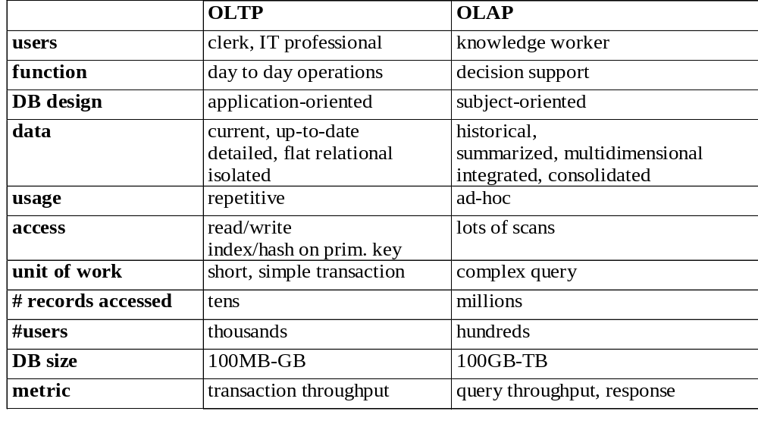
OLTP vs. OLAP

Slide 13
Why Separate Data Warehouse?
High performance for both systems
  DBMS— tuned for OLTP: access methods, indexing, concurrency control, recovery
  Warehouse—tuned for OLAP: complex OLAP queries, multidimensional view, consolidation
Different functions and different data:
  missing data: Decision support requires historical data which operational DBs do not typically maintain
  data consolidation: DS requires consolidation (aggregation, summarization) of data from heterogeneous sources
  data quality: different sources typically use inconsistent data representations, codes and formats which have to be reconciled
Note: There are more and more systems which perform OLAP analysis directly on relational databases

Slide 14
Data Warehouse: A Multi-Tiered Architecture
Monitor
&
Integrator
OLAP Server
Other
sources
Metadata
Analysis
Query
Reports
Data mining
Operational
DBs
Extract
Transform
Load
Refresh
Data
Warehouse
Serve
Data Marts
Data Sources
Data Storage
OLAP Engine
Front-End Tools

Slide 15
Three Data Warehouse Models
Enterprise warehouse
  collects all of the information about subjects spanning the entire organization
Data Mart
  a subset of corporate-wide data that is of value to a specific groups of users. Its scope is confined to specific, selected groups, such as marketing data mart
    Independent vs. dependent (directly from warehouse) data mart
Virtual warehouse
  A set of views over operational databases
  Only some of the possible summary views may be materialized

Slide 16
Extraction, Transformation, and Loading (ETL)
Data extraction
  get data from multiple, heterogeneous, and external sources
Data cleaning
  detect errors in the data and rectify them when possible
Data transformation
  convert data from legacy or host format to warehouse format
Load
  sort, summarize, consolidate, compute views, check integrity, and build indices and partitions
Refresh
  propagate the updates from the data sources to the warehouse

Slide 17
Metadata Repository
Meta data is the data defining warehouse objects. It stores:
  Description of the structure of the data warehouse
    schema, view, dimensions, hierarchies, derived data defn, data mart locations and contents
  Operational meta-data
    data lineage (history of migrated data and transformation path), currency of data (active, archived, or purged), monitoring information (warehouse usage statistics, error reports, audit trails)
  The algorithms used for summarization
  The mapping from operational environment to the data warehouse
  Data related to system performance
    warehouse schema, view and derived data definitions
  Business data
    business terms and definitions, ownership of data, charging policies

Slide 18
Data Lake
A data lake is a centralized repository storing all structured and unstructured data at any scale in an organization
Data is stored as is,
  without having first to structure the data, and run different types of analytics—from dashboards and visualizations to big data processing, real-time analytics, and machine learning to guide better decision
https://azure.microsoft.com/en-in/resources/cloud-computing-dictionary/what-is-a-data-lake

Slide 19
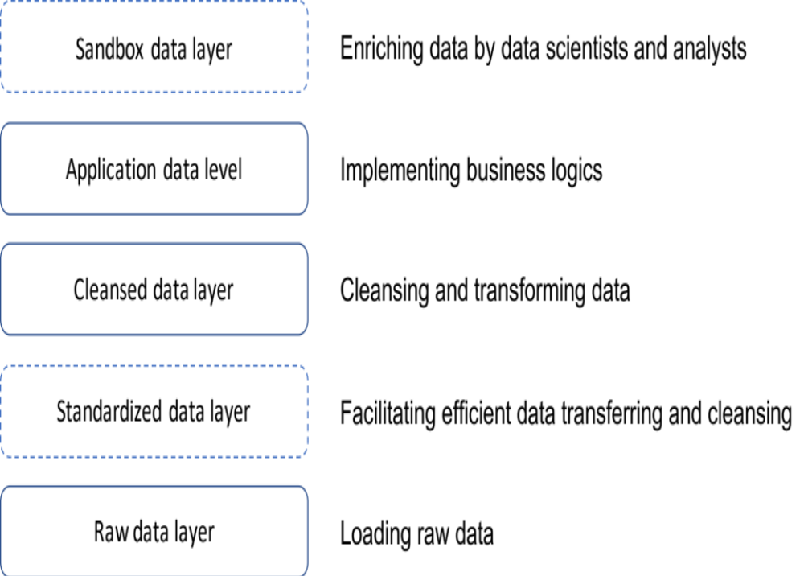
Layers of Storage

Slide 20
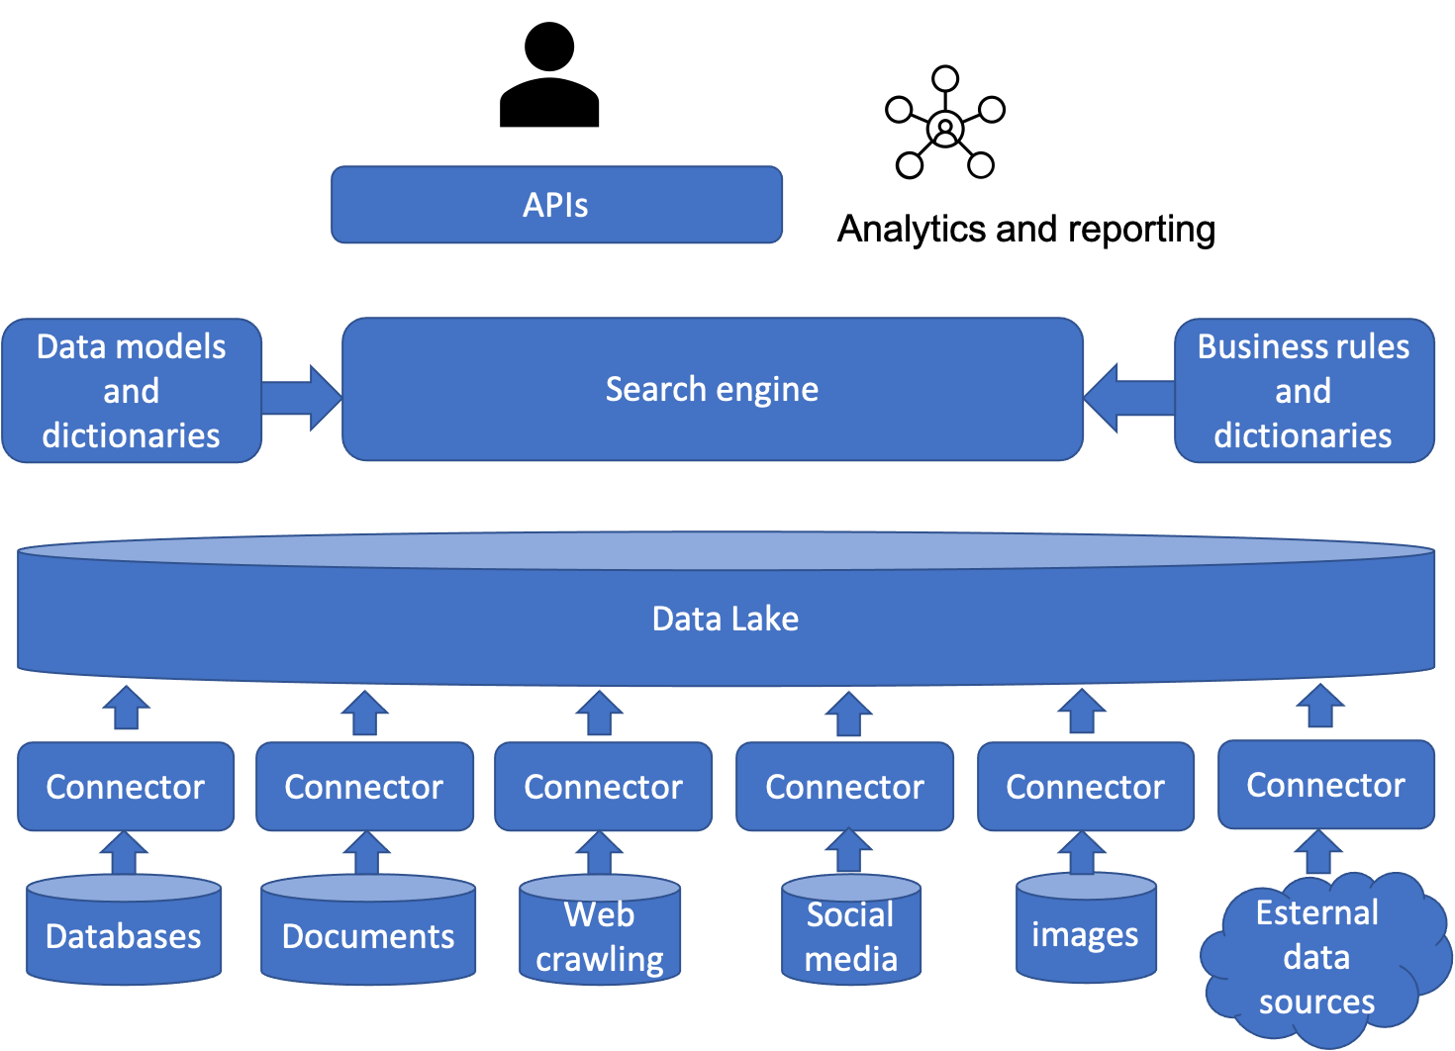
Conceptual Architecture

Slide 21
Two Purposes and Ecosystems
Analytic use cases: decision support based on data
  Data warehouses
  Structured data, SQL/Python
Operational use cases: data intelligence in applications
  Data lakes
  Raw data, Java/Scala, Python, R, and SQL
Potential convergence of data warehouses and data lakes

Slide 22
Data Lakehouse
A data lakehouse is an open standards-based storage solution that is multifaceted in nature.
  It can address the needs of data scientists and engineers who conduct deep data analysis and processing and traditional data warehouse professionals who curate and publish data for business intelligence and reporting purposes.
  The beauty of the lakehouse is that each workload can seamlessly operate on top of the data lake without having to duplicate the data into another structurally predefined database.
  This ensures that everyone is working on the most up-to-date data while also reducing redundancies.

Slide 23
Data Warehousing and OLAP Technology: An Overview
Data Warehouse: Basic Concepts
Data Warehouse Modeling: Data Cube and OLAP
Data Warehouse Design and Usage
Data Warehouse Implementation
Data Generalization by Attribute-Oriented Induction
Summary

Slide 24

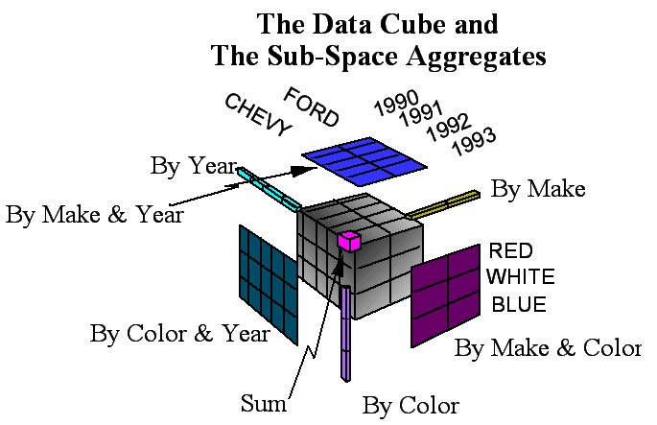
CUBE Operator
Problems with GROUP BY
  GROUP BY cannot directly construct:
    Histograms
    Roll-Up Reports
    Cross-Tabs
CUBE Operator
  Generalize GROUP BY and Roll-Up and Cross-Tabs!!

Slide 25
CUBE Operator
Think of the N-dimensional Cube
N-dimensional Aggregate [sum(), max(),...]
  Fits relational model exactly:
    a₁, a₂, ...., a_{N}, f()
Super-aggregate over N-1 Dimensional sub-cubes
    ALL, a₂, ...., a_{N} , f()
    a₃ , ALL, a₃, ...., a_{N} , f()
    ...
    a₁, a₂, ...., ALL, f()
  This is the N-1 Dimensional cross-tab.
Super-aggregate over N-2 Dimensional sub-cubes
    ALL, ALL, a₃, ...., a_{N} , f()
    ...
    a₁, a₂ ,...., ALL, ALL, f()
…

Slide 26
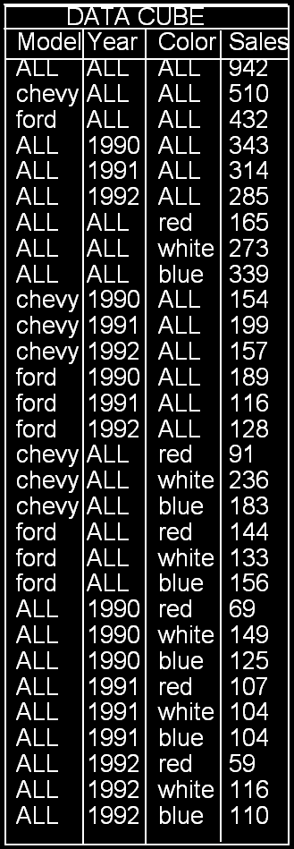
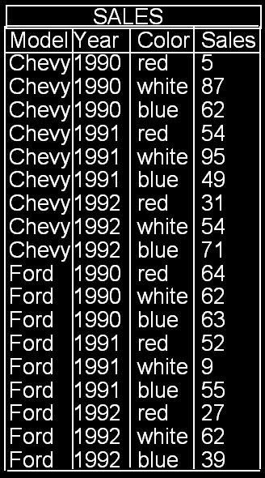
CUBE Operator
An Example
CUBE
Think of ALL as a token representing the set
  {red, white, blue}
  {1990, 1991, 1992}
  {Chevy, Ford}

Slide 27
From Tables and Spreadsheets to Data Cubes
A data warehouse is based on a multidimensional data model which views data in the form of a data cube
A data cube, such as sales, allows data to be modeled and viewed in multiple dimensions
  Dimension tables, such as item (item_name, brand, type), or time(day, week, month, quarter, year)
  Fact table contains measures (such as dollars_sold) and keys to each of the related dimension tables
In data warehousing literature, an n-D base cube is called a base cuboid. The top most 0-D cuboid, which holds the highest-level of summarization, is called the apex cuboid. The lattice of cuboids forms a data cube.

Slide 28
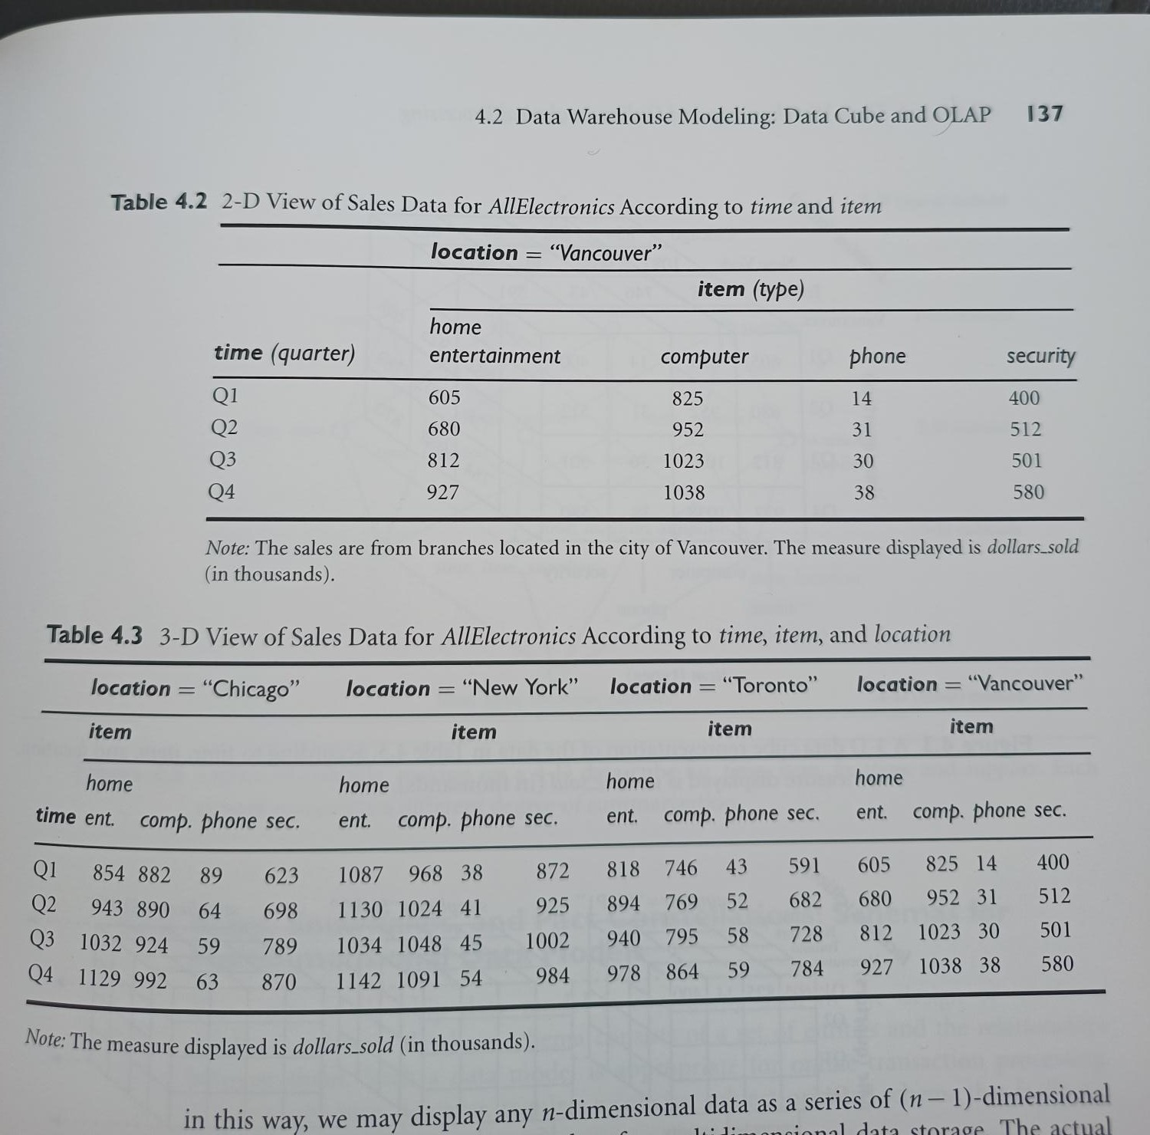

Slide 29
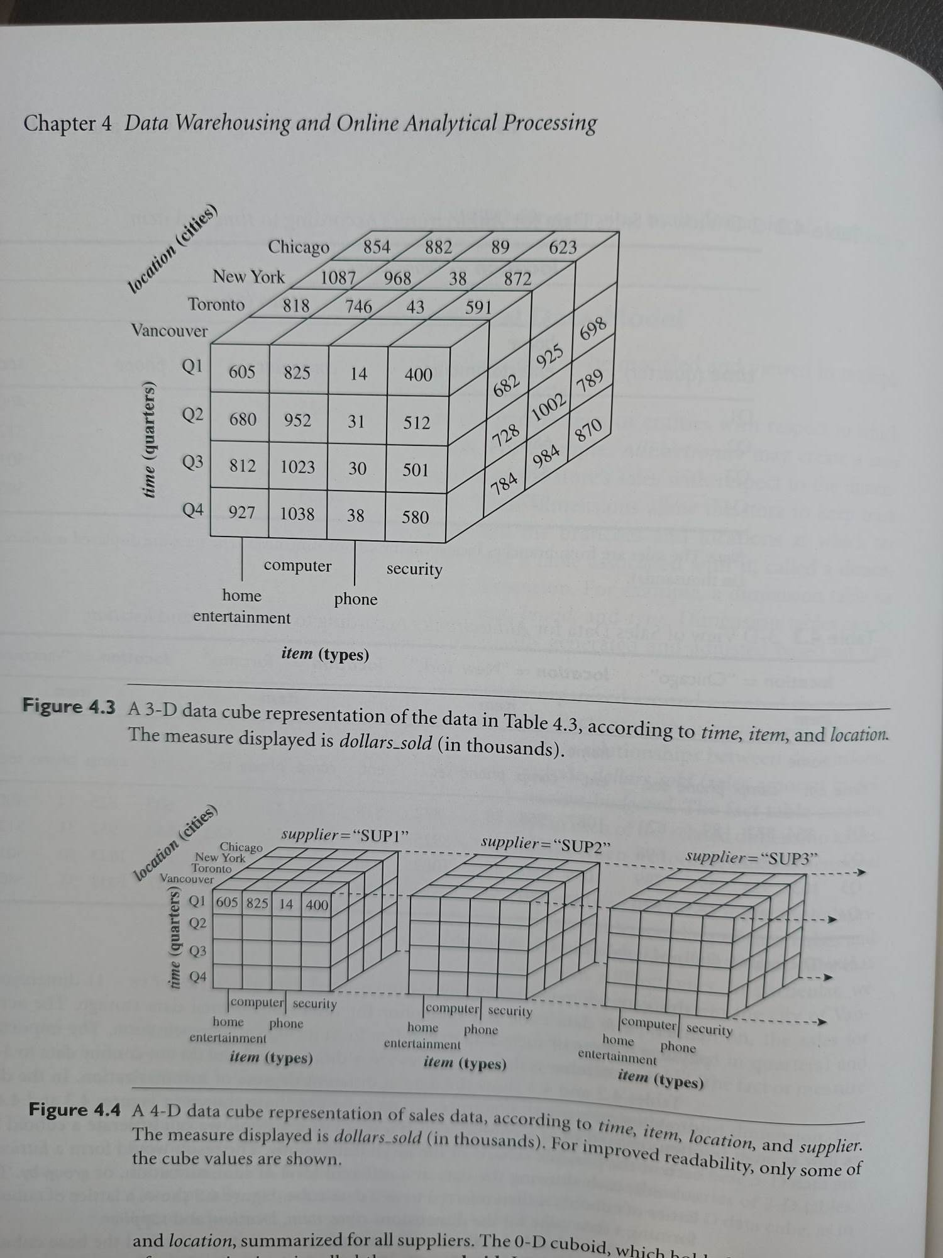

Slide 30
Cube: A Lattice of Cuboids
all
0-D(apex) cuboid
time
item
location
supplier
1-D cuboids
time,location
item,location
location,supplier
time,item
2-D cuboids
time,supplier
item,supplier
time,location,supplier
3-D cuboids
time,item,location
time,item,supplier
item,location,supplier
4-D(base) cuboid
time, item, location, supplier

Slide 31
Conceptual Modeling of Data Warehouses
Modeling data warehouses: dimensions & measures
  Star schema: A fact table in the middle connected to a set of dimension tables
  Snowflake schema: A refinement of star schema where some dimensional hierarchy is normalized into a set of smaller dimension tables, forming a shape similar to snowflake
  Fact constellations: Multiple fact tables share dimension tables, viewed as a collection of stars, therefore called galaxy schema or fact constellation

Slide 32
Example of Star Schema
time
time_key
day
day_of_the_week
month
quarter
year
item
item_key
item_name
brand
type
supplier_type
Sales Fact Table
time_key
item_key
branch_key
branch
location
location_key
branch_key
branch_name
branch_type
location_key
street
city
state_or_province
country
units_sold
dollars_sold
avg_sales
Measures

Slide 33
Example of Snowflake Schema
time
item
time_key
day
day_of_the_week
month
quarter
year
item_key
item_name
brand
type
supplier_key
supplier
Sales Fact Table
supplier_key
supplier_type
time_key
item_key
branch_key
branch
location
location_key
location_key
street
city_key
branch_key
branch_name
branch_type
units_sold
dollars_sold
city
city_key
city
state_or_province
country
avg_sales
Measures

Slide 34
Example of Fact Constellation
time
time_key
day
day_of_the_week
month
quarter
year
item
Shipping Fact Table
item_key
item_name
brand
type
supplier_type
Sales Fact Table
time_key
time_key
item_key
shipper_key
item_key
branch_key
from_location
branch
location_key
location
to_location
branch_key
branch_name
branch_type
units_sold
location_key
street
city
province_or_state
country
dollars_cost
dollars_sold
units_shipped
avg_sales
shipper
Measures
shipper_key
shipper_name
location_key
shipper_type

Slide 35
Cube Definition Syntax (BNF) in Data Mining Query Language (DMQL)
Cube Definition (Fact Table)
  define cube <cube_name> [<dimension_list>]: <measure_list>
Dimension Definition (Dimension Table)
  define dimension <dimension_name> as (<attribute_or_subdimension_list>)
Special Case (Shared Dimension Tables)
  First time as “cube definition”
  define dimension <dimension_name> as <dimension_name_first_time> in cube <cube_name_first_time>

Slide 36
Defining Star Schema in DMQL
define cube sales_star [time, item, branch, location]:
    dollars_sold = sum(sales_in_dollars), avg_sales = avg(sales_in_dollars), units_sold = count(*)
define dimension time as (time_key, day, day_of_week, month, quarter, year)
define dimension item as (item_key, item_name, brand, type, supplier_type)
define dimension branch as (branch_key, branch_name, branch_type)
define dimension location as (location_key, street, city, province_or_state, country)

Slide 37
Defining Snowflake Schema in DMQL
define cube sales_snowflake [time, item, branch, location]:
    dollars_sold = sum(sales_in_dollars), avg_sales = avg(sales_in_dollars), units_sold = count(*)
define dimension time as (time_key, day, day_of_week, month, quarter, year)
define dimension item as (item_key, item_name, brand, type, supplier(supplier_key, supplier_type))
define dimension branch as (branch_key, branch_name, branch_type)
define dimension location as (location_key, street, city(city_key, province_or_state, country))

Slide 38
Defining Fact Constellation in DMQL
define cube sales [time, item, branch, location]:
    dollars_sold = sum(sales_in_dollars), avg_sales = avg(sales_in_dollars), units_sold = count(*)
define dimension time as (time_key, day, day_of_week, month, quarter, year)
define dimension item as (item_key, item_name, brand, type, supplier_type)
define dimension branch as (branch_key, branch_name, branch_type)
define dimension location as (location_key, street, city, province_or_state, country)
define cube shipping [time, item, shipper, from_location, to_location]:
    dollar_cost = sum(cost_in_dollars), unit_shipped = count(*)
define dimension time as time in cube sales
define dimension item as item in cube sales
define dimension shipper as (shipper_key, shipper_name, location as location in cube sales, shipper_type)
define dimension from_location as location in cube sales
define dimension to_location as location in cube sales

Slide 39
A Concept Hierarchy: Dimension (location)
Definition: A concept hierarchy defines a sequence of mappings from a set of low-level concepts to higher-level, more general concepts.
all
all
region
Europe
...
North_America
country
Germany
...
Spain
Canada
...
Mexico
city
Frankfurt
...
Vancouver
...
Toronto
office
L. Chan
...
M. Wind

Slide 40
Measures of Data Cube: Three Categories
A measure in data cube is a numeric function which can be computed at each point in data space.
Distributive: if the result derived by applying the function to n aggregate values is the same as that derived by applying the function on all the data without partitioning
    E.g., count(), sum(), min(), max()
Algebraic: if it can be computed by an algebraic function with M arguments (where M is a bounded integer), each of which is obtained by applying a distributive aggregate function
    E.g., avg(), min_N(), standard_deviation()
    Avg() can be computed by sum()/count() with two arguments, both sum() and count() are distributed aggregate functions.
Holistic: if there is no constant bound on the storage size needed to describe a sub-aggregate.
    E.g., median(), mode(), rank()

Slide 41


View of Warehouses and Hierarchies
Specification of hierarchies
Schema hierarchy
  day < {month < quarter; week} < year
Set_grouping hierarchy
  {1..10} < inexpensive

Slide 42
Multidimensional Data
Sales volume as a function of product, month, and region
Dimensions: Product, Location, Time
Hierarchical summarization paths
Region
Industry Region Year
Category Country Quarter
Product City Month Week
Office Day
Product
Month

Slide 43

A Sample Data Cube
Date
Total annual sales
of TV in U.S.A.
1Qtr
2Qtr
3Qtr
4Qtr
sum
Product
TV
PC
U.S.A
VCR
sum
Canada
Country
Mexico
sum
All, All, All

Slide 44
Cuboids Corresponding to the Cube
all
0-D(apex) cuboid
product
date
country
1-D cuboids
product,date
product,country
date, country
2-D cuboids
3-D(base) cuboid
product, date, country

Slide 45

Browsing a Data Cube
Visualization
OLAP capabilities
Interactive manipulation

Slide 46
Typical OLAP Operations
Roll up (drill-up): summarize data
  by climbing up hierarchy or by dimension reduction
Drill down (roll down): reverse of roll-up
  from higher level summary to lower level summary or detailed data, or introducing new dimensions
Slice and dice: project and select
Pivot (rotate):
  reorient the cube, visualization, 3D to series of 2D planes
Other operations
  drill across: involving (across) more than one fact table
  drill through: through the bottom level of the cube to its back-end relational tables (using SQL)

Slide 47

Fig. 3.10 Typical OLAP Operations

Slide 48
A Star-Net Query Model
A Star-Net model consists of radial lines emanating from a central point, where each line represents a concept hierarchy of a dimension.
Each abstraction level or a circle in the hierarchy is called footprint.
It represents the granularities available for use by OLAP operations such as drill-down and roll-up.

Slide 49
A Star-Net Query Model
Customer Orders
Shipping Method
Customer
CONTRACTS
AIR-EXPRESS
ORDER
TRUCK
PRODUCT LINE
Time
Product
ANNUALY
QTRLY
DAILY
PRODUCT ITEM
PRODUCT GROUP
CITY
SALES PERSON
COUNTRY
DISTRICT
REGION
DIVISION
Location
Each circle is called a footprint
Promotion
Organization

Slide 50
Data Warehousing and OLAP Technology: An Overview
Data Warehouse: Basic Concepts
Data Warehouse Modeling: Data Cube and OLAP
Data Warehouse Design and Usage
Data Warehouse Implementation
Data Generalization by Attribute-Oriented Induction
Summary

Slide 51
Design of Data Warehouse: A Business Analysis Framework
Four views regarding the design of a data warehouse
  Top-down view
    allows selection of the relevant information necessary for the data warehouse
  Data source view
    exposes the information being captured, stored, and managed by operational systems
  Data warehouse view
    consists of fact tables and dimension tables
  Business query view
    sees the perspectives of data in the warehouse from the view of end-user

Slide 52
Data Warehouse Design Process
Top-down, bottom-up approaches or a combination of both
  Top-down: Starts with overall design and planning (mature)
  Bottom-up: Starts with experiments and prototypes (rapid)
From software engineering point of view
  Waterfall: structured and systematic analysis at each step before proceeding to the next
  Spiral: rapid generation of increasingly functional systems, short turn around time, quick turn around
Typical data warehouse design process
  Choose a business process to model, e.g., orders, invoices, etc.
  Choose the grain (atomic level of data) of the business process
  Choose the dimensions that will apply to each fact table record
  Choose the measure that will populate each fact table record

Slide 53
Data Warehouse Development: A Recommended Approach
Multi-Tier Data Warehouse
Distributed Data Marts
Enterprise Data Warehouse
Data Mart
Data Mart
Model refinement
Model refinement
Define a high-level corporate data model

Slide 54
Data Warehouse Usage
Three kinds of data warehouse applications
  Information processing
    supports querying, basic statistical analysis, and reporting using crosstabs, tables, charts and graphs
  Analytical processing
    multidimensional analysis of data warehouse data
    supports basic OLAP operations, slice-dice, drilling, pivoting
  Data mining
    knowledge discovery from hidden patterns
    supports associations, constructing analytical models, performing classification and prediction, and presenting the mining results using visualization tools

Slide 55
From On-Line Analytical Processing (OLAP) to On Line Analytical Mining (OLAM)
Why online analytical mining?
  High quality of data in data warehouses
    DW contains integrated, consistent, cleaned data
  Available information processing structure surrounding data warehouses
    ODBC (Open Database Connectivity), OLEDB (Object Linking and Embedding, Database), Web accessing, service facilities, reporting and OLAP tools
  OLAP-based exploratory data analysis
    Mining with drilling, dicing, pivoting, etc.
  On-line selection of data mining functions
    Integration and swapping of multiple mining functions, algorithms, and tasks

Slide 56
Data Warehousing and OLAP Technology: An Overview
Data Warehouse: Basic Concepts
Data Warehouse Modeling: Data Cube and OLAP
Data Warehouse Design and Usage
Data Warehouse Implementation
Data Generalization by Attribute-Oriented Induction
Summary

Slide 57

Efficient Data Cube Computation
Data cube can be viewed as a lattice of cuboids
  The bottom-most cuboid is the base cuboid
  The top-most cuboid (apex) contains only one cell
  How many cuboids in an n-dimensional cube with L levels?
Materialization of data cube
  Materialize every (cuboid) (full materialization), none (no materialization), or some (partial materialization)
  Selection of which cuboids to materialize
    Based on size, sharing, access frequency, etc.

Slide 58
Cube Operation
Cube definition and computation in DMQL
    define cube sales[item, city, year]: sum(sales_in_dollars)
    compute cube sales
Transform it into a SQL-like language (with a new operator cube by, introduced by Gray et al.’96)
    SELECT item, city, year, SUM (amount)
    FROM SALES
    CUBE BY item, city, year
Need compute the following Group-Bys
    (date, product, customer),
    (date,product),(date, customer), (product, customer),
    (date), (product), (customer)
    ()
()
(city)
(item)
(year)
(city, item)
(city, year)
(item, year)
(city, item, year)

Slide 59
Bitmap indexes
Assume that records have permanent numbers
A bit-map index is a collection of bit vectors of length n, one for each value may appear in the field F.
The vector for value v has 1 in position i if the i’th record has v in field F, and it has 0 there if not.
Example for F and G fields:
  (30, foo), (30,bar), (40, baz), (50, foo), (40, bar), (30, baz)
  Bit index for F, each of 6 bits. For 30, it is 110001, for 40, it is 001010, and for 50, it is 000100.
  Bit index for G also have three vectors. For “foo” it is, 100100, for “bar” it is 010010, and for “baz” it is 001001.

Slide 60
Bit map indexes: Partial match
Bit maps allow answering of partial match queries quickly and efficiently.
Example:
  Movie(title, year, length, studioName)
  SELECT title
  FROM Movie
  WHERE studioName= ‘Disney’ and Year=1965;
If we have bitmap for studioName and year, then intersection or AND operation will give the result.
Bit vectors do not occupy much space.

Slide 61
Bitmap indexes: range queries
Example: consider the gold jewelry data of twelve points
  1 (25,60), 2(45,60), 3(50,75), 4(50,100), 5(50,120), 6(70, 110), 7(85,140), 8(30,260), 9(25,400), 10(45,350), 11(50,275), 12(60,260)
Age has seven different values
  25(100000001000), 30(000000010000), 45(010000000100), 50(001110000010), 60(000000000001), 70(000001000000)
  85(000000100000)
Salary has 10 different values
  60(000000000000), 75(001000000000), 100(000100000000)
  110(000001000000), 120(000010000000), 140(000000100000)
  260(000000010001), 275(000000000010), 350(000000000100)
  400(000000001000),

Slide 62
Example continued
Find the jewelry buyers with an age range 45-55 and salary in the range 100-200
Find the bit vectors of for the age values in the range and take OR
  010000000100 (for 45) and 001110000010 (for 50)
  Result: 011110000110
Find the bit vectors of salaries between 100 and 200 thousand.
  There are four: 100,110,120, and 140, their bitwaise OR is 000111100000
Take AND of both bit vectors
  000110000000
  Find two records (50,100) and (50,120) are in the range.

Slide 63



Indexing OLAP Data: Bitmap Index
Index on a particular column
Each value in the column has a bit vector: bit-op is fast
The length of the bit vector: # of records in the base table
The i-th bit is set if the i-th row of the base table has the value for the indexed column
not suitable for high cardinality domains
  A bit compression technique, Word-Aligned Hybrid (WAH), makes it work for high cardinality domain as well [Wu, et al. TODS’06]
Base table
Index on Region
Index on Type

Slide 64

Indexing OLAP Data: Join Indices
Join index: JI(R-id, S-id) where R (R-id, …)  S (S-id, …)
Traditional indices map the values to a list of record ids
  It materializes relational join in JI file and speeds up relational join
In data warehouses, join index relates the values of the dimensions of a start schema to rows in the fact table.
  E.g. fact table: Sales and two dimensions city and product
    A join index on city maintains for each distinct city a list of R-IDs of the tuples recording the Sales in the city
  Join indices can span multiple dimensions

Slide 65
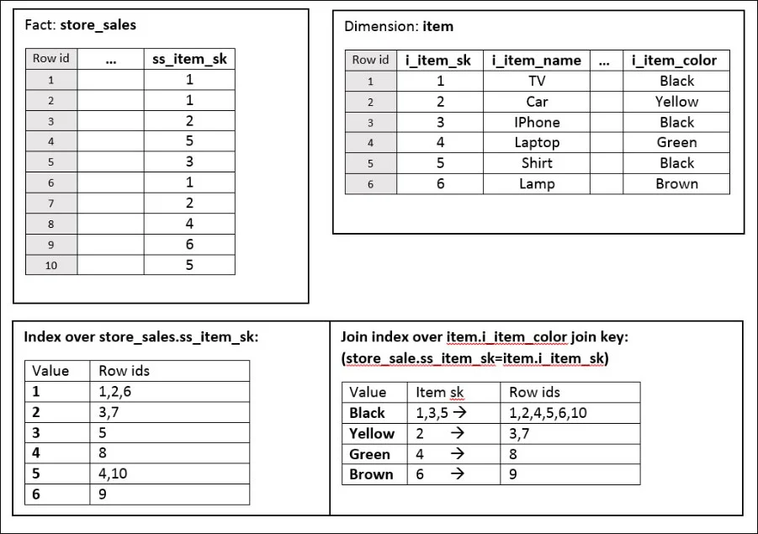
Example of the join index

Slide 66
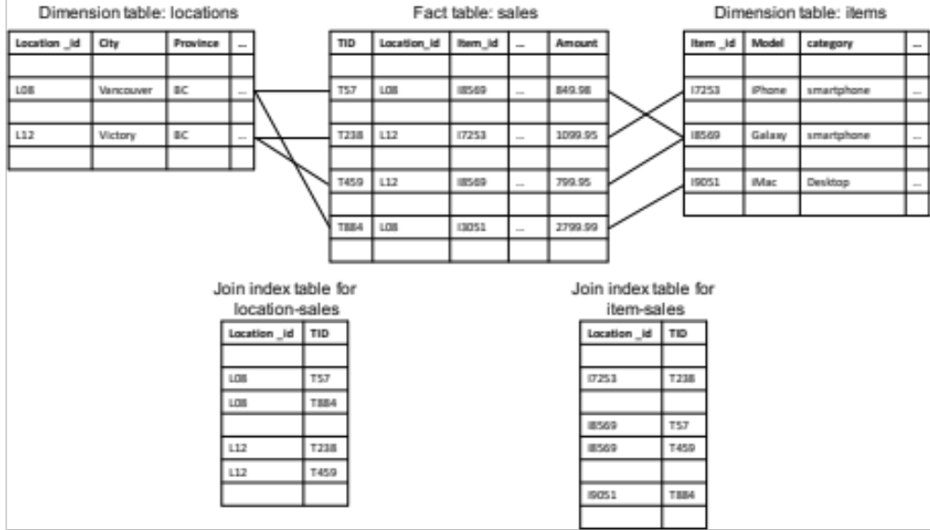
Join Index Example

Slide 67
Horizontal versus Vertical Storage
A fact table for data warehousing is often fat
  Tens of even hundreds of dimensions/attributes
A query is often about only a few attributes
Horizontal storage: tuples are stored one by one
Vertical storage: tuples are stored by attributes
A₁ | A₂ | … | A₁₀₀
x₁ | x₂ | … | x₁₀₀
… | … | … | …
z₁ | z₂ | … | z₁₀₀
A₁ | A₂ | … | A₁₀₀
x₁ | x₂ | … | x₁₀₀
… | … | … | …
z₁ | z₂ | … | z₁₀₀

Slide 68
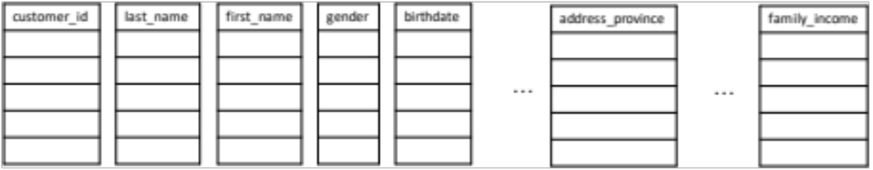
Column-based Storage
Reference:
Michael Stonebraker, Daniel J. Abadi, Adam Batkin, Xuedong Chen,
Mitch Cherniack, Miguel Ferreira, Edmond Lau, Amerson Lin, Samuel Madden,
Elizabeth J. O'Neil, Patrick E. O'Neil, Alex Rasin, Nga Tran,
Stanley B. Zdonik: C-Store: A Column-oriented DBMS. VLDB 2005: 553-564

Slide 69
Efficient Processing OLAP Queries
Determine which operations should be performed on the available cuboids
  Transform drill, roll, etc. into corresponding SQL and/or OLAP operations, e.g., dice = selection + projection
Determine which materialized cuboid(s) should be selected for OLAP op.
  Let the query to be processed be on {brand, province_or_state} with the condition “year = 2004”, and there are 4 materialized cuboids available:
    1) {year, item_name, city}
    2) {year, brand, country}
    3) {year, brand, province_or_state}
    4) {item_name, province_or_state} where year = 2004
    Which should be selected to process the query?
Explore indexing structures and compressed vs. dense array structs in MOLAP

Slide 70
OLAP Server Architectures
Relational OLAP (ROLAP)
  Use relational or extended-relational DBMS to store and manage warehouse data and OLAP middle ware
  Include optimization of DBMS backend, implementation of aggregation navigation logic, and additional tools and services
  Greater scalability
Multidimensional OLAP (MOLAP)
  Sparse array-based multidimensional storage engine
  Fast indexing to pre-computed summarized data
Hybrid OLAP (HOLAP) (e.g., Microsoft SQLServer)
  Flexibility, e.g., low level: relational, high-level: array
Specialized SQL servers (e.g., Redbricks)
  Specialized support for SQL queries over star/snowflake schemas

Slide 71
Data Warehousing and OLAP Technology: An Overview
Data Warehouse: Basic Concepts
Data Warehouse Modeling: Data Cube and OLAP
Data Warehouse Design and Usage
Data Warehouse Implementation
Data Generalization by Attribute-Oriented Induction
Summary

Slide 72
Attribute-Oriented Induction
Proposed in 1989 (KDD ‘89 workshop)
Not confined to categorical data nor particular measures
How it is done?
  Collect the task-relevant data (initial relation) using a relational database query
  Perform generalization by attribute removal or attribute generalization
  Apply aggregation by merging identical, generalized tuples and accumulating their respective counts
  Interaction with users for knowledge presentation

Slide 73
Attribute-Oriented Induction: An Example
Example: Describe general characteristics of graduate students in the University database
Step 1. Fetch relevant set of data using an SQL statement, e.g.,
    Select * (i.e., name, gender, major, birth_place, birth_date, residence, phone#, gpa)
    from student
    where student_status in {“Msc”, “MBA”, “PhD” }
Step 2. Perform attribute-oriented induction
Step 3. Present results in generalized relation, cross-tab, or rule forms

Slide 74



Class Characterization: An Example
Initial Relation
Prime Generalized Relation

Slide 75
Basic Principles of Attribute-Oriented Induction
Data focusing: task-relevant data, including dimensions, and the result is the initial relation
Attribute-removal: remove attribute A if there is a large set of distinct values for A but (1) there is no generalization operator on A, or (2) A’s higher level concepts are expressed in terms of other attributes
Attribute-generalization: If there is a large set of distinct values for A, and there exists a set of generalization operators on A, then select an operator and generalize A
Attribute-threshold control: typical 2-8, specified/default
Generalized relation threshold control: control the final relation/rule size

Slide 76
Attribute-Oriented Induction: Basic Algorithm
InitialRel: Query processing of task-relevant data, deriving the initial relation.
PreGen: Based on the analysis of the number of distinct values in each attribute, determine generalization plan for each attribute: removal? or how high to generalize?
PrimeGen: Based on the PreGen plan, perform generalization to the right level to derive a “prime generalized relation”, accumulating the counts.
Presentation: User interaction: (1) adjust levels by drilling, (2) pivoting, (3) mapping into rules, cross tabs, visualization presentations.

Slide 77
Presentation of Generalized Results
Generalized relation:
  Relations where some or all attributes are generalized, with counts or other aggregation values accumulated.
Cross tabulation:
  Mapping results into cross tabulation form (similar to contingency tables).
  Visualization techniques:
  Pie charts, bar charts, curves, cubes, and other visual forms.
Quantitative characteristic rules:
  Mapping generalized result into characteristic rules with quantitative information associated with it, e.g.,

Slide 78
Mining Class Comparisons
Comparison: Comparing two or more classes
Method:
  Partition the set of relevant data into the target class and the contrasting class(es)
  Generalize both classes to the same high level concepts
  Compare tuples with the same high level descriptions
  Present for every tuple its description and two measures
    support - distribution within single class
    comparison - distribution between classes
  Highlight the tuples with strong discriminant features
Relevance Analysis:
  Find attributes (features) which best distinguish different classes

Slide 79
Concept Description vs. Cube-Based OLAP
Similarity:
  Data generalization
  Presentation of data summarization at multiple levels of abstraction
  Interactive drilling, pivoting, slicing and dicing
Differences:
  OLAP has systematic preprocessing, query independent, and can drill down to rather low level
  AOI has automated desired level allocation, and may perform dimension relevance analysis/ranking when there are many relevant dimensions
  AOI works on the data which are not in relational forms

Slide 80
Data Warehousing and OLAP Technology: An Overview
Data Warehouse: Basic Concepts
Data Warehouse Modeling: Data Cube and OLAP
Data Warehouse Design and Usage
Data Warehouse Implementation
Data Generalization by Attribute-Oriented Induction
Summary

Slide 81
Summary
Data warehousing: A multi-dimensional model of a data warehouse
  A data cube consists of dimensions & measures
  Star schema, snowflake schema, fact constellations
  OLAP operations: drilling, rolling, slicing, dicing and pivoting
Data Warehouse Architecture, Design, and Usage
  Multi-tiered architecture
  Business analysis design framework
  Information processing, analytical processing, data mining, OLAM (Online Analytical Mining)
Implementation: Efficient computation of data cubes
  Partial vs. full vs. no materialization
  Indexing OALP data: Bitmap index and join index
  OLAP query processing
  OLAP servers: ROLAP, MOLAP, HOLAP
Data generalization: Attribute-oriented induction

Slide 82
References
Refer to the Bibliographic notes of Chapter 3
Book: Jiawei Han, Jian Pei, Hanghang Tong, Data Mining: Concepts and Techniques, Fourth edition, 2022, Elseiver Inc.

Slide 83
Surplus Slides

Slide 84
Compression of Bitmap Indices
Bitmap indexes must be compressed to reduce I/O costs and minimize CPU usage—majority of the bits are 0’s
Two compression schemes:
  Byte-aligned Bitmap Code (BBC)
  Word-Aligned Hybrid (WAH) code
Time and space required to operate on compressed bitmap is proportional to the total size of the bitmap
Optimal on attributes of low cardinality as well as those of high cardinality.
WAH out performs BBC by about a factor of two
Notes:
K. Wu, E. Otoo, and A. Shoshani, Bitmap Index Compression Optimality, VLDB’04
Need to digest and rewrite it using an example! See full abstract on slide towards end of file.

